Slide 1
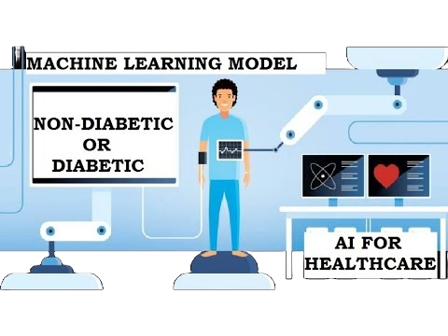

Disease Prediction Using Machine Learning
Leveraging Support Vector Machines for Accurate Diagnosis
- Presented by Arian Rahman Aditta

Slide 2


Introduction
This project focuses on developing a machine learning model for disease prediction, aiming to assist healthcare professionals in accurate diagnosis and timely treatment. By leveraging the Support Vector Machine (SVM) algorithm, we aim to analyze various health attributes and classify individuals into diseased or non-diseased categories. Through this endeavor, we seek to enhance patient care and contribute to the advancement of predictive medicine.

Slide 3


Overview:
In the healthcare sector, accurate disease diagnosis is crucial for timely treatment and effective patient care. Early detection can significantly improve patient outcomes and reduce healthcare costs.
Problem Statement & Objective
Dataset:
We utilized a dataset containing various health-related attributes, such as cholesterol levels, blood cell counts, hormone levels, and other physiological measurements, alongside a binary indicator for disease presence.
Objective:
Our objective is to create a predictive model for accurate disease classification using individual health attributes. Leveraging machine learning algorithms, we strive to improve disease classification accuracy, aiding healthcare professionals in early diagnosis and patient management.

Slide 4
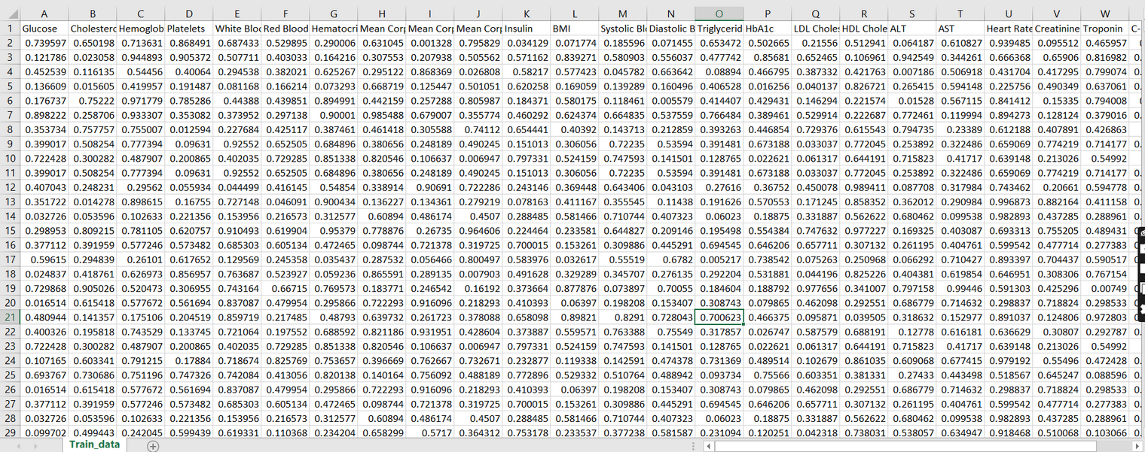

Data Description
Description:
The dataset includes a comprehensive list of health-related attributes, providing valuable insights into an individual's health status:
Cholesterol: Level of cholesterol in the blood (mg/dL)
Hemoglobin: Protein in red blood cells carrying oxygen
Platelets: Blood cells aiding in clotting
White Blood Cells (WBC): Immune system cells fighting infections
Red Blood Cells (RBC): Cells carrying oxygen
Hematocrit: Percentage of blood volume occupied by RBC
Mean Corpuscular Volume (MCV): Average volume of RBC
Insulin: Hormone regulating blood sugar levels
Training Dataset for Disease Prediction Model

Slide 5
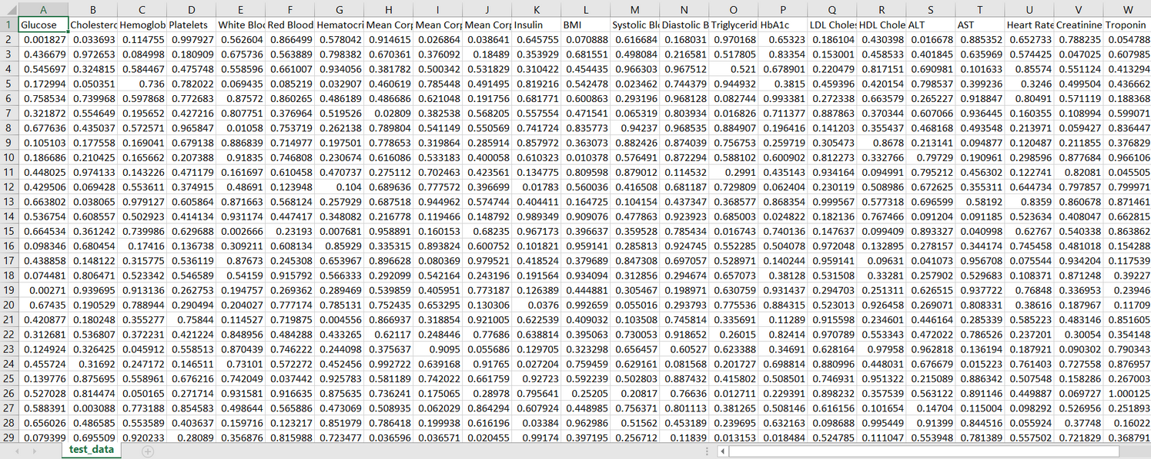
Data Description
BMI (Body Mass Index): Measure of body fat based on height and weight
Systolic Blood Pressure (SBP): Pressure in arteries during heartbeats
Diastolic Blood Pressure (DBP): Pressure in arteries at rest between beats
Triglycerides: Type of fat found in blood (mg/dL)
HbA1c (Glycated Hemoglobin): Measure of average blood sugar levels over the past 2-3 months
LDL (Low-Density Lipoprotein) Cholesterol: "Bad" cholesterol
HDL (High-Density Lipoprotein) Cholesterol: "Good" cholesterol
ALT (Alanine Aminotransferase): Liver enzyme
AST (Aspartate Aminotransferase): Enzyme found in the liver and heart
Heart Rate: Number of heartbeats per minute (bpm)
Creatinine: Waste product produced by muscles and filtered by kidneys
Test Dataset for Disease Prediction Model

Slide 6
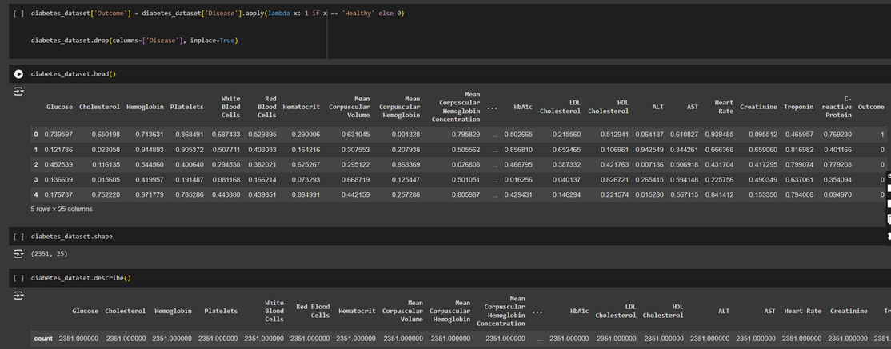
Load and Preprocess the Training Data
Description :
Loading the Training Dataset: Importing the training dataset containing health-related attributes and disease indicators to commence model development.
Data Preprocessing Steps:
Target Encoding: Transforming the categorical target variable 'Disease' into numerical values (1 for 'Healthy' and 0 for 'Unhealthy') to facilitate model training.
Column Dropping: Eliminating redundant columns, such as 'Disease', from the dataset to simplify analysis and reduce computational overhead.
Data Preprocessing

Slide 7
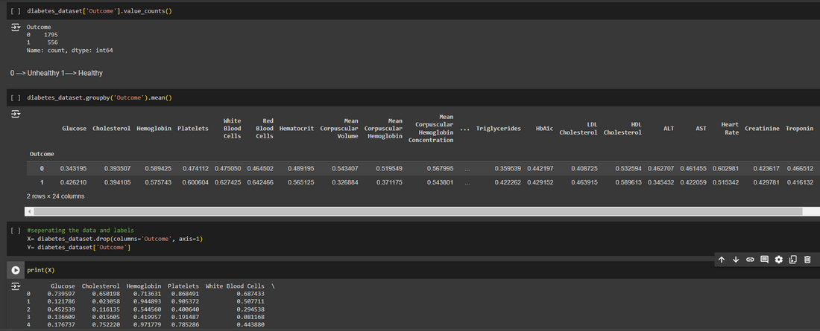
Load and Preprocess the Training Data
Description :
Standardization: Employing standardization techniques to scale input features, ensuring uniformity across variables and enhancing model performance by mitigating the impact of varying feature scales.
Data Standardization

Slide 8
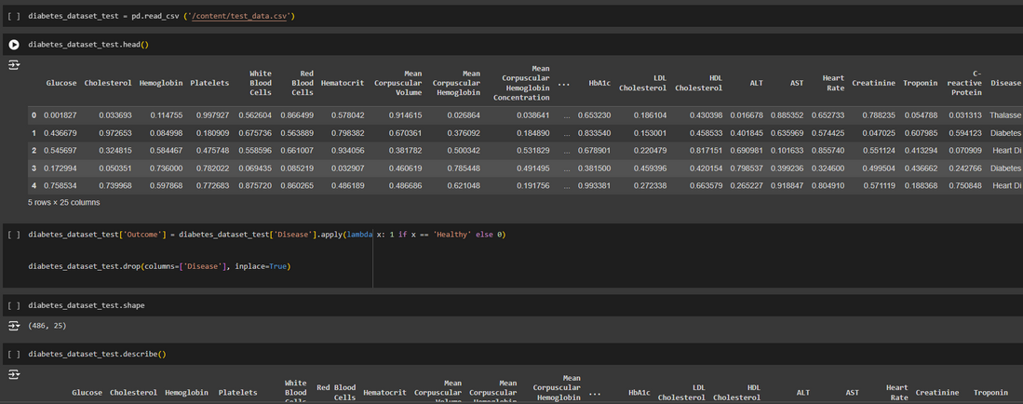
Load and Preprocess the Test Data
Description:
Loading Test Dataset: The test dataset is loaded to evaluate the trained model's performance on new data. This dataset contains health-related attributes and disease indicators, similar to the training data.
Preprocessing Steps: Similar preprocessing steps as the training data are applied to the test dataset. This includes handling any missing values, encoding categorical variables, and standardizing the input features to ensure uniformity and compatibility with the trained model.
Preparing for Evaluation: The test set is prepared for model evaluation and prediction. By preprocessing the test data in a consistent manner, we ensure that the evaluation process is reliable and reflects the real-world performance of the model on unseen data.
Data Preprocessing and Standardization

Slide 9
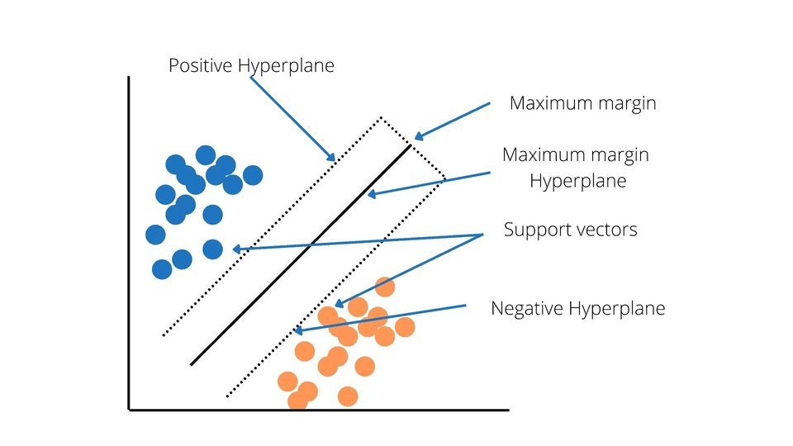
Model Development :
SVM (Support Vector Machine) :
Support Vector Machine (SVM) is a powerful supervised learning algorithm used for both classification and regression tasks. It works by finding the optimal hyperplane that best separates the classes in the feature space. SVM aims to maximize the margin between the decision boundary and the nearest data points from each class, making it robust and effective in high-dimensional spaces. Additionally, SVM can handle non-linear decision boundaries through the use of kernel functions, which map the original feature space into a higher-dimensional space where linear separation is possible.
Support Vector Machine

Slide 10
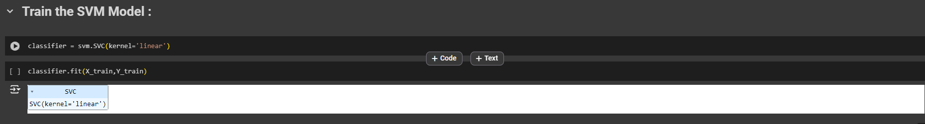
Model Development :
Support Vector Machine (SVM): SVM is a powerful supervised learning algorithm known for its effectiveness in binary classification tasks.
Linear Kernel: Utilizing a linear kernel for the SVM model to classify individuals into diseased and non-diseased categories based on their health attributes.
Model Training: Training the SVM classifier using standardized training data to learn the optimal decision boundary for disease prediction.
Hyperplane Optimization: SVM aims to maximize the margin between classes, resulting in robust and generalizable models.
SVM Note: SVM is particularly suitable for scenarios with clear class boundaries and can handle non-linear decision boundaries through kernel functions.
Model Training

Slide 11
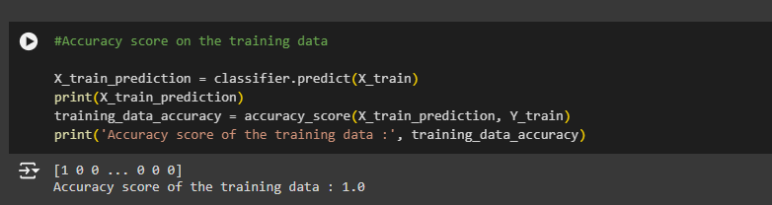
Training Data Evaluation
Description:
Performance Assessment: Assessing the performance of the trained SVM model on the training dataset is crucial to determine its effectiveness in learning from the provided data.
Accuracy Score Calculation: The accuracy score, a widely used evaluation metric, is computed to measure the model's predictive capability on the training set. It indicates the proportion of correctly classified instances out of the total instances in the training data.
Model Accuracy: The SVM model achieves an impressive accuracy score of 1.0 when predicting on the training data, indicating that it perfectly classifies the instances in the training set.
Training Data Evaluation

Slide 12
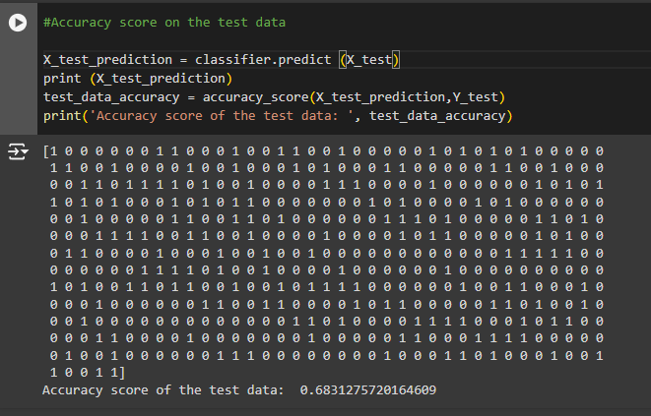
Test Data Evaluation
Description:
Performance Assessment: Evaluating the performance of the trained SVM model on the test dataset is essential to assess its ability to generalize to unseen data.
Accuracy Score Calculation: The accuracy score is calculated to measure the model's predictive accuracy on the test set. It indicates the proportion of correctly classified instances out of the total instances in the test data.
Model Generalization: The SVM model achieves an accuracy score of approximately 0.6831 when predicting on the test data, indicating its ability to generalize to new, unseen instances. However, there is still room for improvement to enhance the model's performance further.
Test Data Evaluation

Slide 13
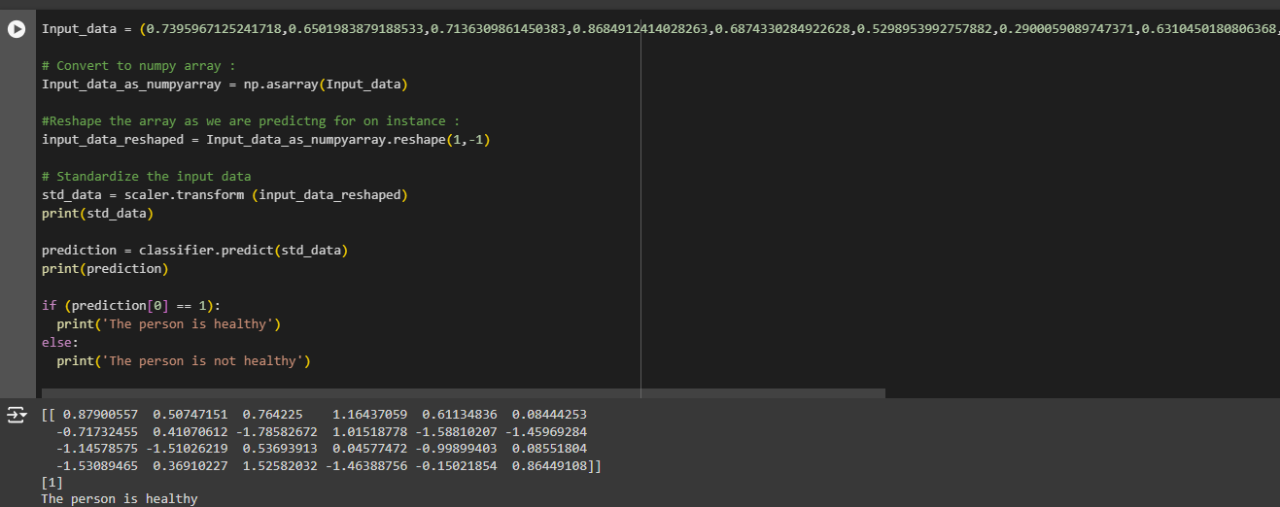
Make Predictions on New Data
Description:
Utilizing Trained Model: We employ the trained Support Vector Machine (SVM) model to predict disease likelihood on new data instances, a pivotal step for real-world applications.
Example Input Data: The provided example input data encompasses various health-related attributes standardized for optimal model compatibility.
Prediction Outcome: The SVM model predicts the disease likelihood based on the input data, providing a binary classification result (1: Diseased, 0: Non-diseased).
Interpretation and Actionable Insights: Interpretation of the model prediction facilitates healthcare professionals in taking appropriate actions, such as recommending further diagnostic tests or initiating preventive measures.
Making Predictions

Slide 14
Outcome
Effective Disease Prediction: The developed Support Vector Machine (SVM) model demonstrates robust predictive power in classifying individuals as diseased or non-diseased based on their health attributes.
Significance in Healthcare: Accurate disease classification enables early detection, facilitating timely interventions and personalized patient management strategies. This enhances overall healthcare outcomes and patient satisfaction.
Potential for Integration: The SVM model holds potential for integration into healthcare systems and clinical workflows, empowering healthcare professionals with reliable predictive tools for informed decision-making.
Future Directions: Continued research and development efforts aim to enhance model performance further, explore additional healthcare applications, and promote wider adoption of predictive modeling in clinical practice.
Key Takeaways:
The SVM model offers a valuable tool for proactive disease management and preventive healthcare strategies.
Its successful implementation underscores the transformative potential of machine learning in advancing healthcare delivery and patient outcomes.

Slide 15






THANK TOU
For watching this presentation
Arian Rahman Aditta
+88-01730496689
aryanrahmanaditta@gmail.com
https://www.linkedin.com/in/aryanrahman-aditta-79392a265/
https://github.com/AryanAditta

